Slide 1
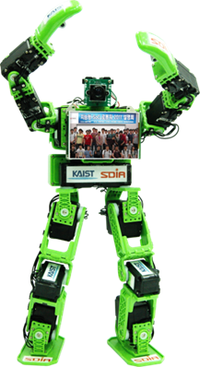
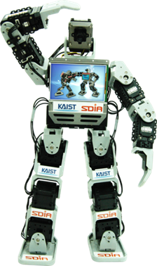
Compiler Installation Guide
Design of Intelligent SoC Robot
(aka Embedded Systems Design and Implementation)
http://ssl.kaist.ac.kr/class/18fall/socrobotdesign
Hoi-Jun Yoo
KAIST

Slide 2
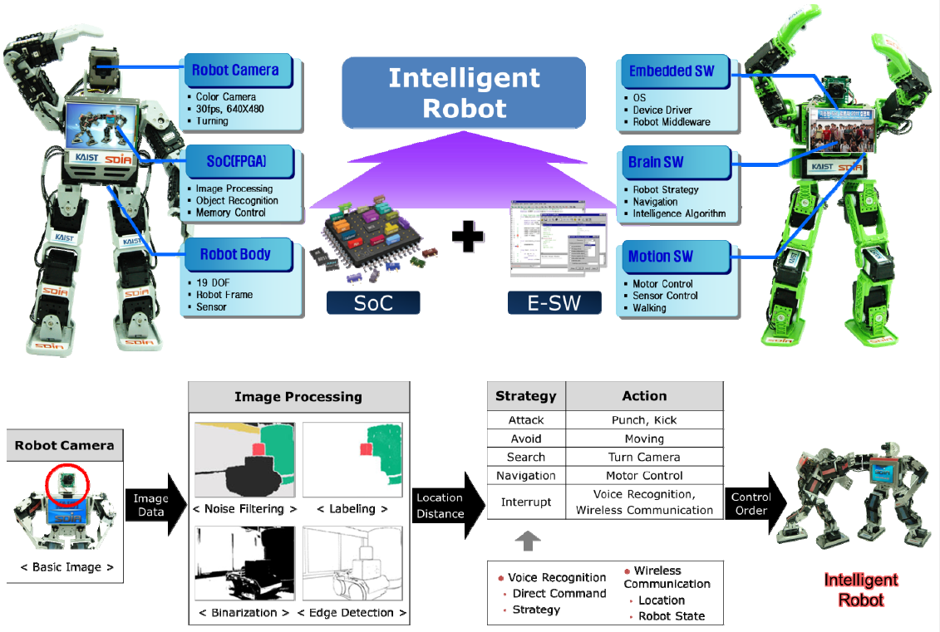
Intelligent SoC Robot Algorithm

Slide 3
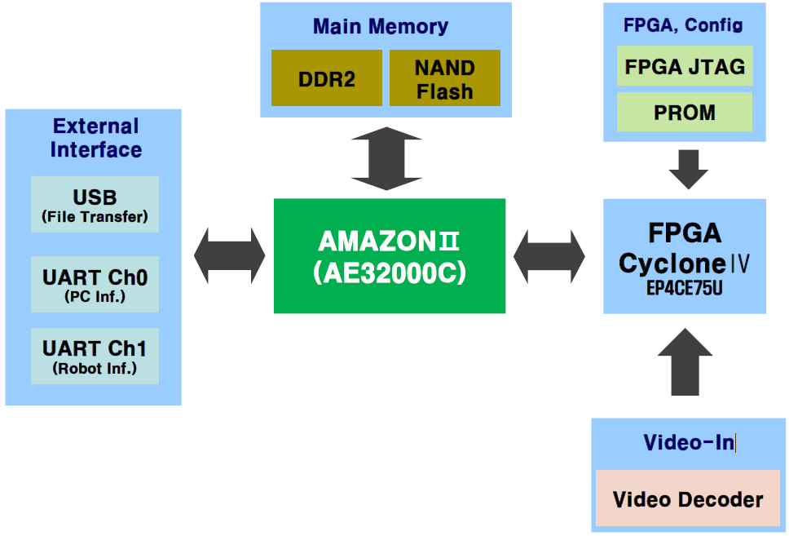
Brain Board Block Diagram

Slide 4
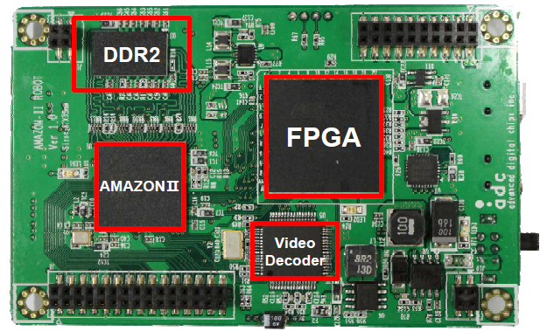
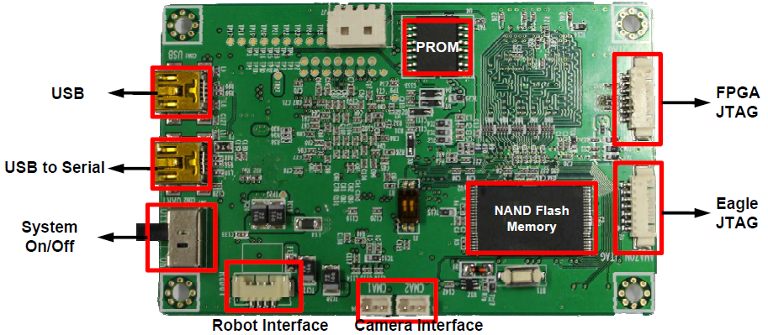
Brain Board (Main Board)
Top
Bottom

Slide 5
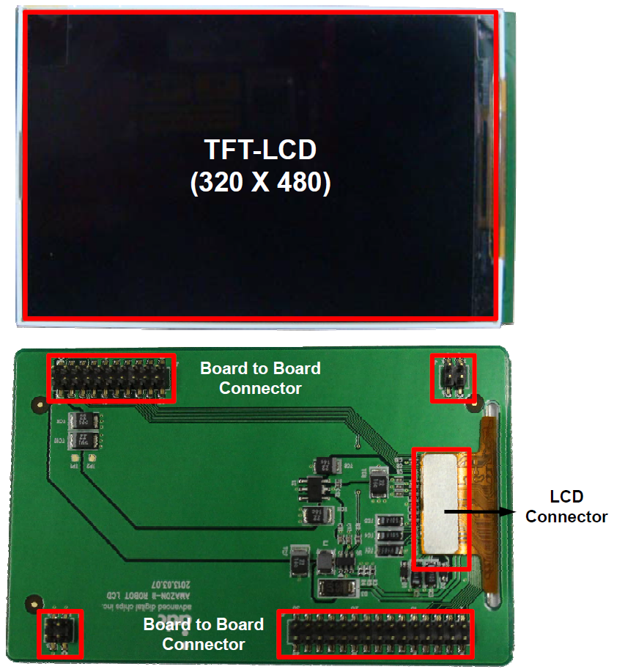
Brain Board (Main Board)
Top
Bottom

Slide 6
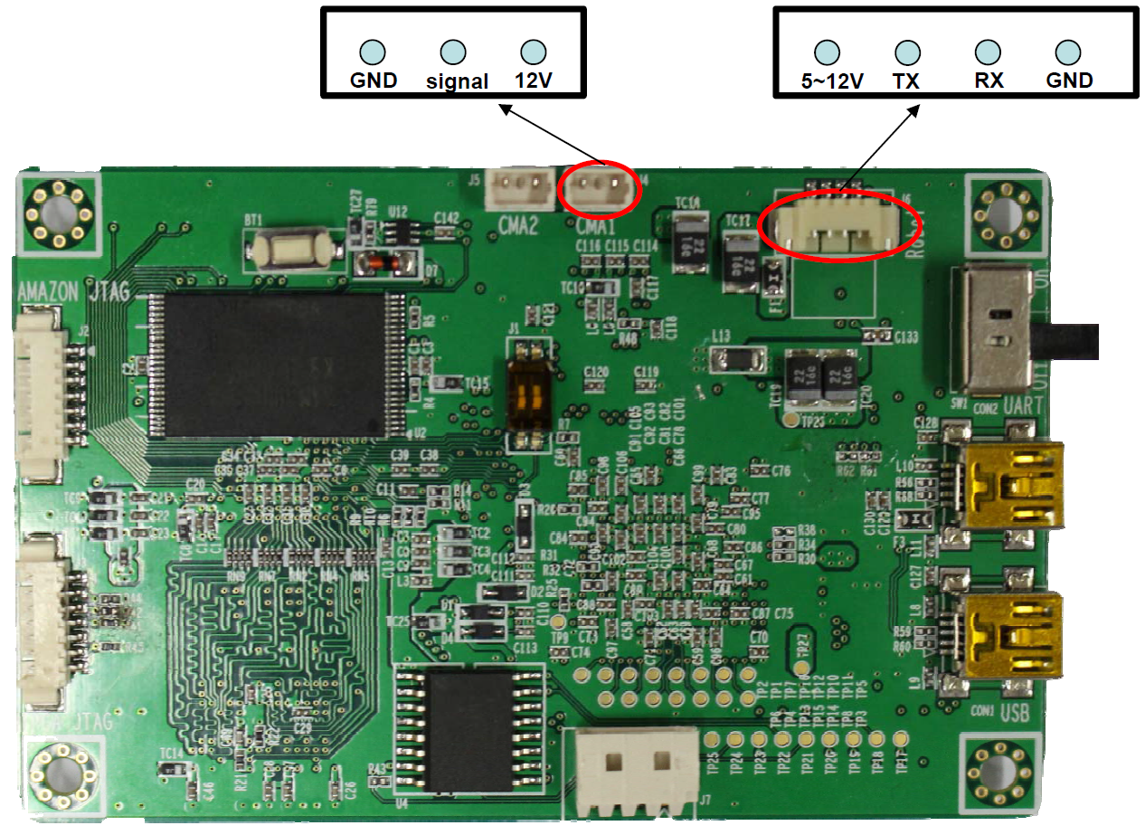
Brain Board (Main Board)
Connector Pin Information

Slide 7
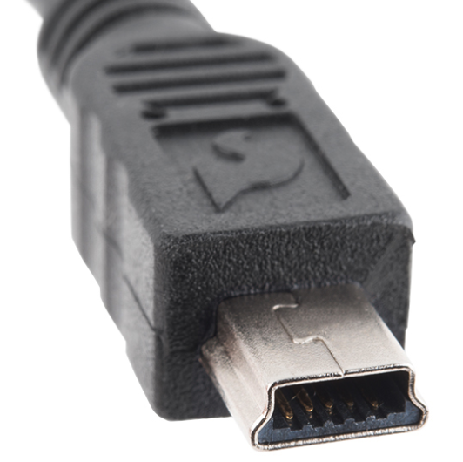
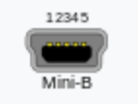
SoC Brain Board Development Environment
Hardware
PC
SoC Brain Board
USB Mini B-type Cable, 2ea
DC 5V Power Adapter (2A)
NTSC output Camera (12V)
Software
OS: Windows7(Recommended), Windows 8
Cygwin (gcc operation environment)
AE32000C Compiler
USB Download Program, USB Drive
Hyper Terminal (Putty)

Slide 8
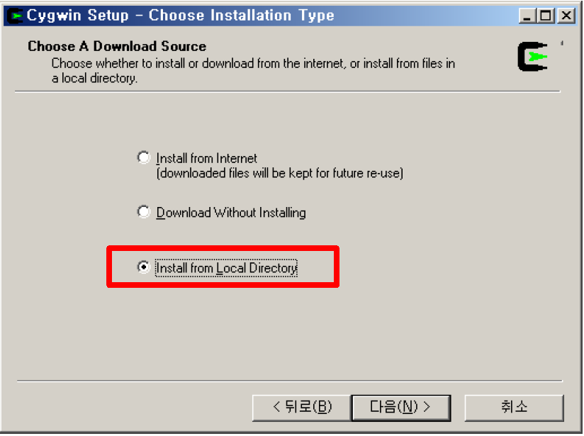
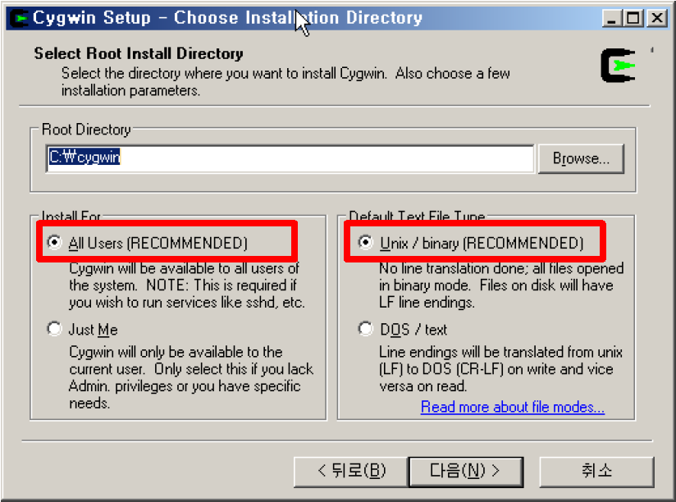
Install Cygwin
Install Cygwin
Unzip cygwin_source.zip file
Execute cygwin_source/setup.exe
Set Root Directory to C:\Cygwin
Install For : All Users
Default Text File Type: Unix / binary Check
Next
Next

Slide 9
Install Cygwin
Install Cygwin
Select Package : All Install
OK
Next
Next

Slide 10
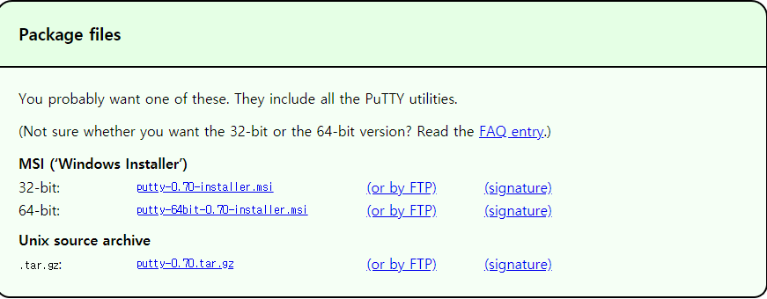
Install Other SW
Brain board SW
Download AMAZON2_robot_v1.13.4_package.tar.gz
Install Putty
Install Putty https://www.chiark.greenend.org.uk/~sgtatham/putty/latest.html

Slide 11
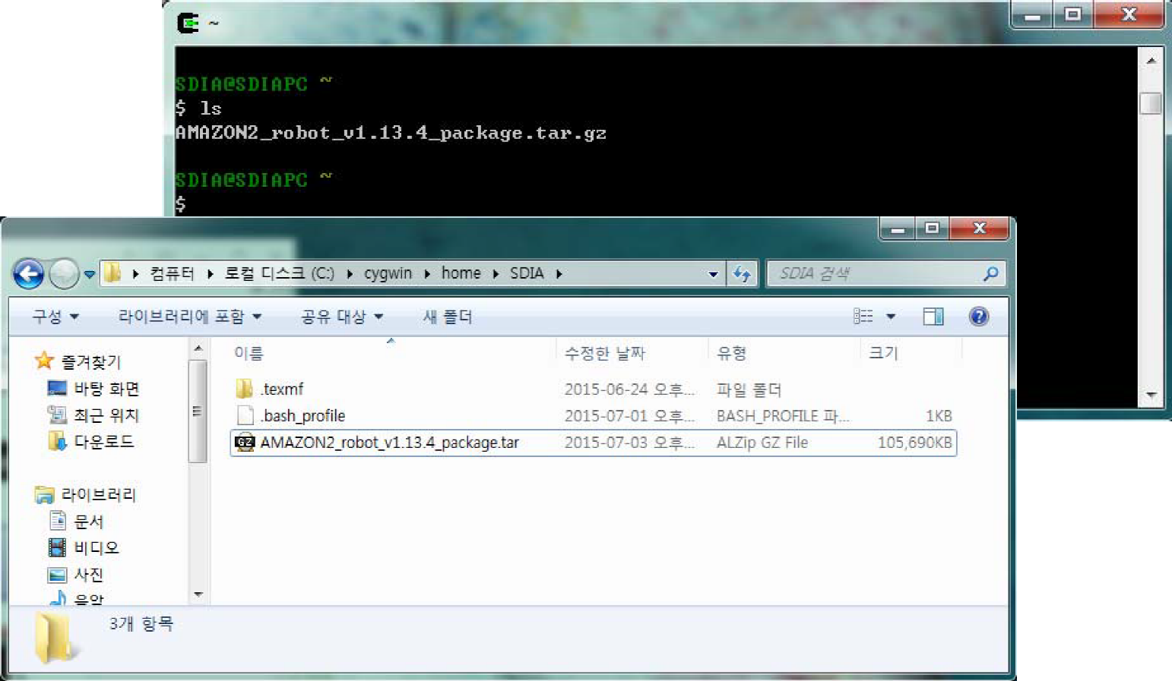
Compiler Installation
Compiler Installation
Copy AMAZON2_robot_v1.13.14_package.tar.gz
to C:\cygwin\home\<user ID>

Slide 12
Linux Command
Command | Description
ls | List directory contents
cd | Change the current directory
cp | Copy files or directories
mv | Rename or move files or directories
mkdir | Make a new directory
cat | Display file’s contents to the standard output device
tar | Store and extract files from a tarfile (.tar) or tarball (.tar.gz or .tgz)
pwd | Print the current directory
chmod | Change a file’s permissions
clear | Clear a command line screen/window
date | Display the system time

Slide 13
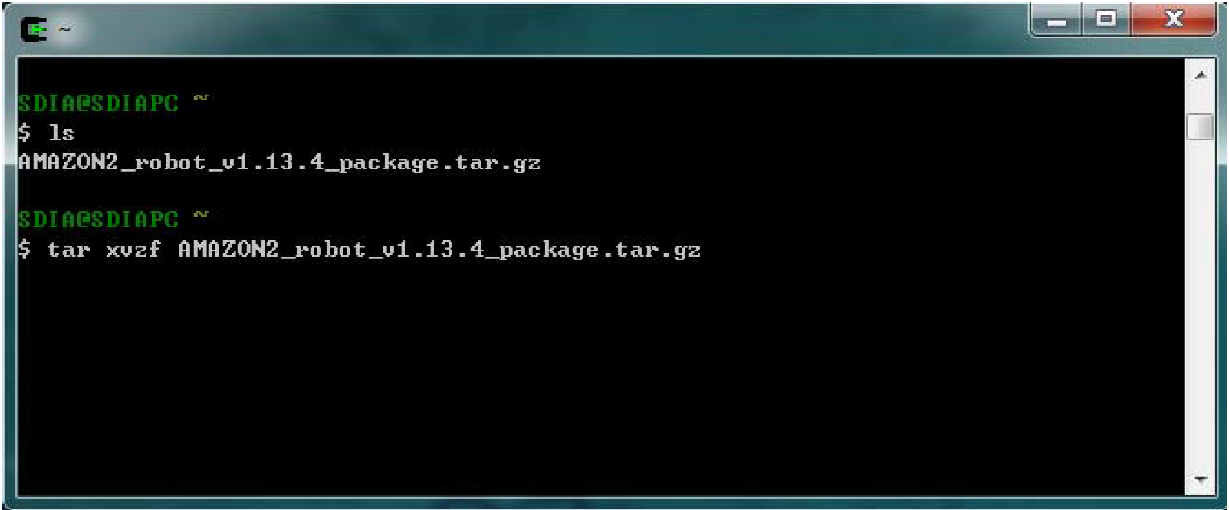
Compiler Installation
Compiler Installation
Execute Cygwin
Type below command
$ tar xvzf AMAZON2_robot_v1.13.4_package.tar.gz

Slide 14
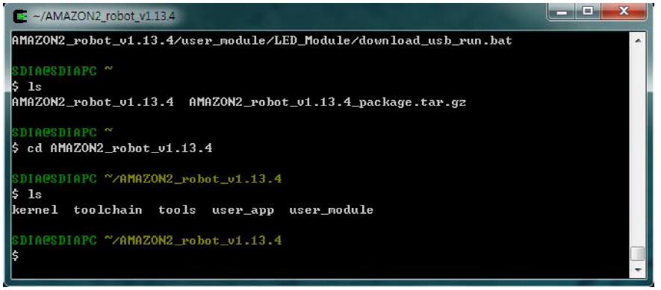
Compiler Installation
Compiler Installation
Move to other folder
$ ls
$ cd AMAZON2_robot_v1.13.4
$ ls

Slide 15
Compiler Installation
Compiler Installation
Toolchain unzip
$ cd toolchain
$ cp ae32000-elf-uclibc-tools-AE32000C-v2.6.4.tar.gz /usr/local
$ cd /usr/local
$ tar xfz ae32000-elf-uclibc-tools-AE32000C-v2.6.4.tar.gz

Slide 16
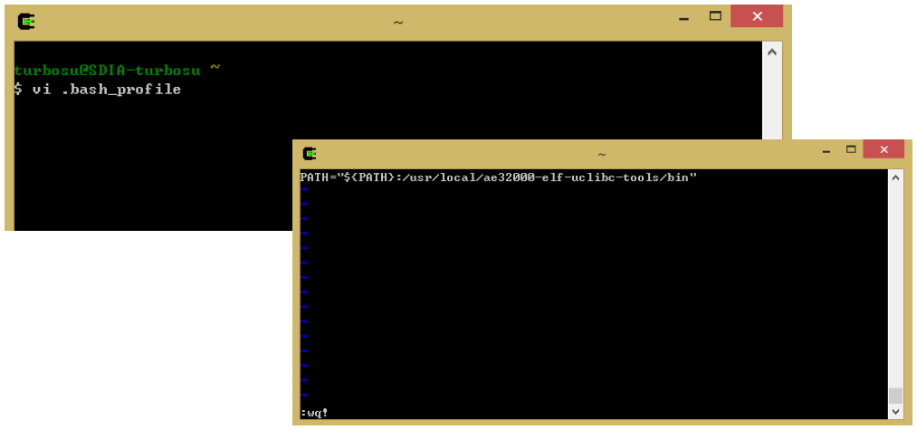
Compiler Installation
Compiler Installation
Make shell file
$ vi .bash_profile
Add following PATH to vi editor and save
PATH=“${PATH}:/usr/local/ae32000-elf-uclibc-tools/bin”

Slide 17
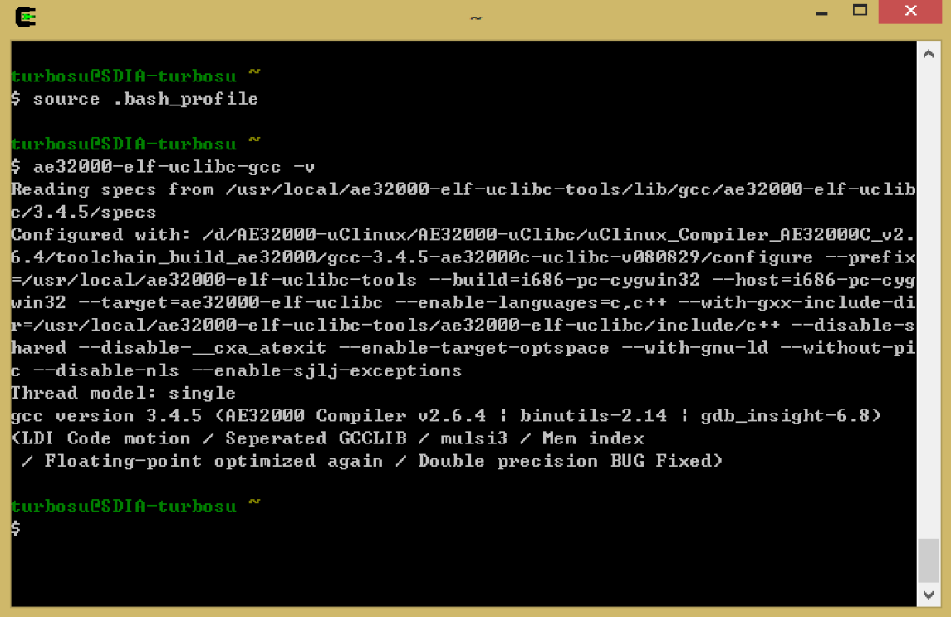
Compiler Installation
Compiler Installation
Verify installation
$ source .bash_profile
$ ae32000-elf-uclibc-gcc -v

Slide 18
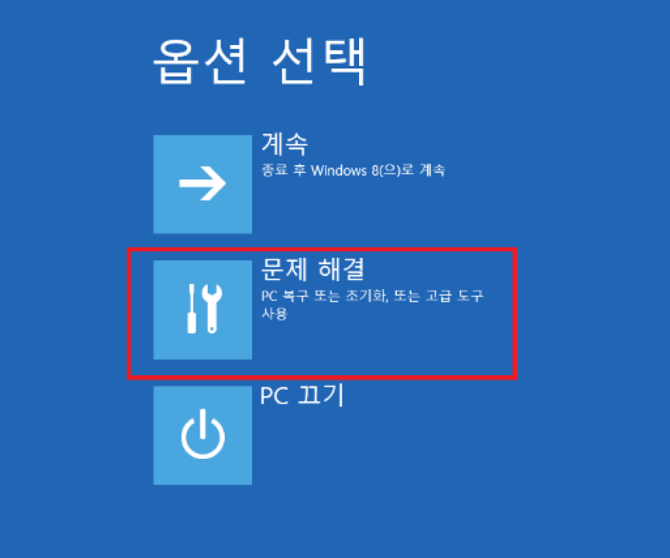
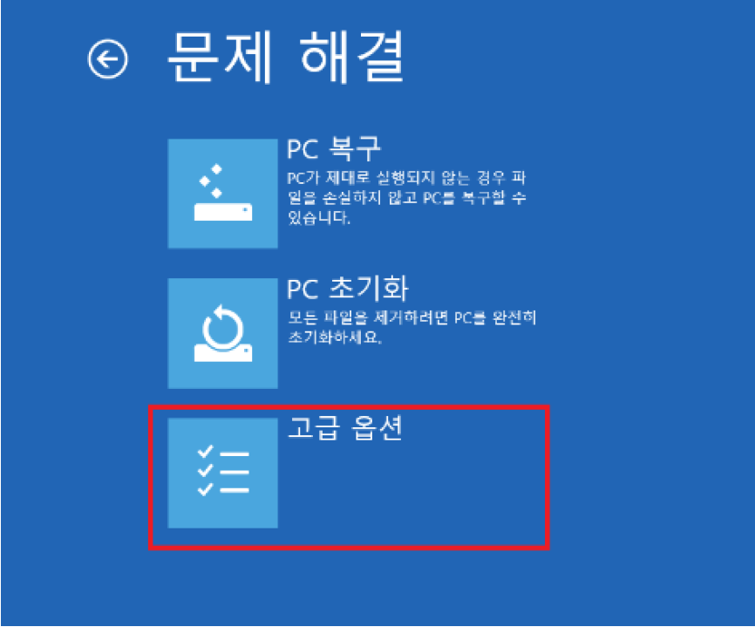
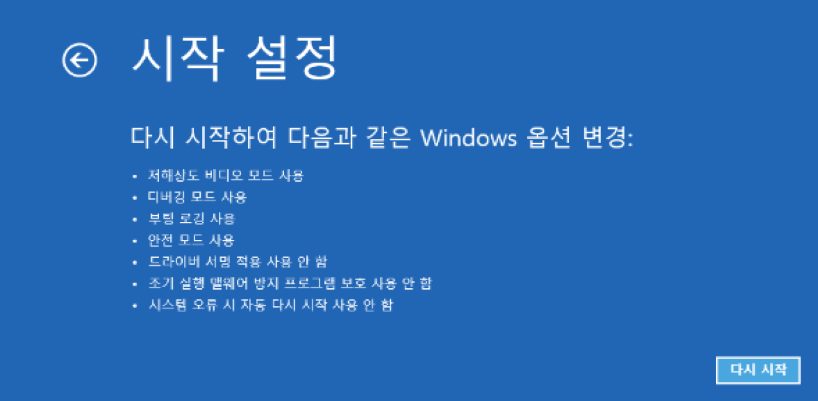
Driver Installation
USB Driver Installation
Shift + restart
Click trouble shoot
Click advanced Options
Restart
Disable driver signature enforcement

Slide 19
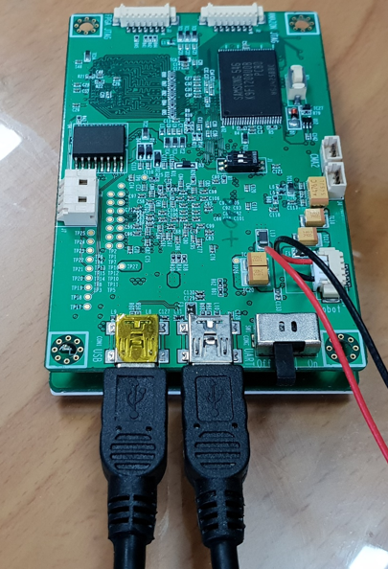
Driver Installation
USB Driver Installation
Connect mini B USB cable to COM1, COM2 port
USB port
Power switch

Slide 20
Driver Installation
USB Driver Installation
Device manager → Other device → right click CP2102 USB to UART Bridge Controller
Update driver → Browse my computer for driver software
SELECT AMAZON2_robot_v1.13.4/tools/usb_to_serial_driver

Slide 21
Driver Installation
USB Driver Installation
Device manager → Other device → Right click unidentified device
Update driver → Browse my computer for driver software
Browse → select AMAZON2_robot_v1.13.4/tools/usb_driver
Install driver
Other device
Unidentified device
Universal Serial Bus controller

Slide 22
Driver Installation
Putty Configuration
Connection type : Serial
Serial line : COM xx (get the number from device manager)
Speed : 115200
open
COM12

Slide 23
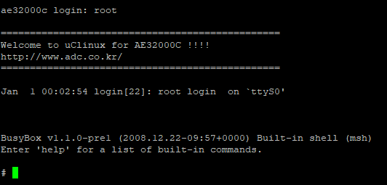
Driver Installation
Kernal Ramdisk Installation
Ae32000c login: root
Then you can communicate with board
# usb_download

Slide 24
Driver Installation
Kernal Ramdisk Installation
Move to AMAZON2_robot_v1.13.4/tools folder
Execute download_usb_nand.bat
Execute download_usb_image.bat

Slide 25
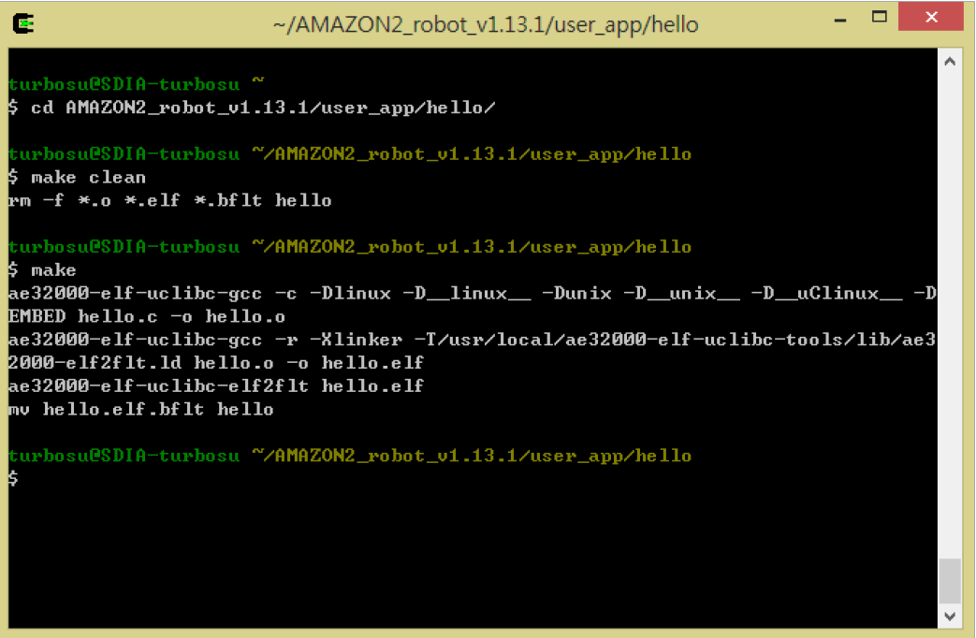
Application SW
Application SW Complilation
Open cygwin
Type below command
$ cd AMAZON2_robot_v1.13.4/user_app/graphic_test
$ make clean (delete every files)
$ make (compile and generate executable file)

Slide 26
Application SW
Download File (PC → Board)
Open folder AMAZON2_robot_v1.13.4/user_app/
Copy graphic_test file to AMAZON2_robot_v1.13.4/tools/
Open putty
ae32000c login: root
# usb_download
Execute AMAZON2_robot_v1.13.4/tools/RemoteManCLI.exe
Type below command to download file PC
RemoteMan<‘q’ to exit> > target usb
RemoteMan<‘q’ to exit> > rfw /mnt/f0/graphic_test graphic_test
RemoteMan<‘q’ to exit> > run 0
※ rfw /mnt/f0/<file_name> <file_name>
※ if RemoteManCLI.exe does not identify the board, unplug and plug the USB cable

Slide 27
Application SW
Execute File
Open putty
ae32000c login: root
# cd /mnt/f0
# chmod 777 graphic_test (change graphic_test file to executable)
# ./graphic_test (execute graphic_test file)

Slide 28
Application SW
Upload File (Board → PC)
Open putty
ae32000c login: root
# usb_download
Execute AMAZON2_robot_v1.13.4/tools/RemoteManCLI.exe
Type below command to download file PC
RemoteMan<‘q’ to exit> > target usb
RemoteMan<‘q’ to exit> > rfr /mnt/f0/graphic_test graphic_test
RemoteMan<‘q’ to exit> > run 0
※ rfr /mnt/f0/<file_name> <file_name>
※ if RemoteManCLI.exe does not identify the board, unplug and plug the USB cable

Slide 29
Application SW
App SW Autoplay
Autoplay : Execute designated program after booting automatically.
Open putty
ae32000c login: root
# cd /mnt/f0
# vi user_init
Write below text to automatically execute hello file
# chmod 777 user_init
#!/bin/sh
Cd /mnt/f0
./hello &

Slide 30
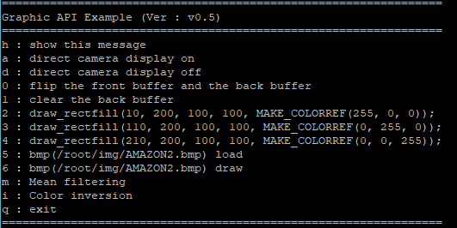
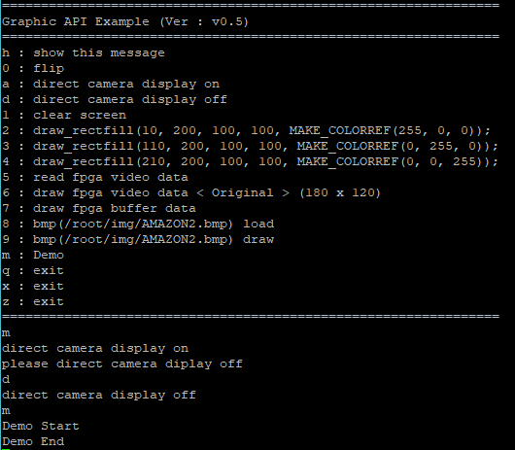
Demo SW
Demo SW Execution
Type m to start mean filtering
Type d to turn off direct camera

Slide 31
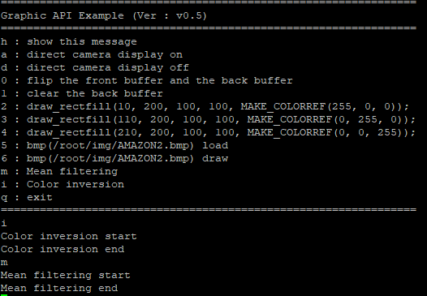
Demo SW
Demo SW Execution
Type i to start color inversion
Type m to start mean filtering

Slide 32
Demo SW
Demo SW Execution
What is front buffer?
What is back buffer?

Slide 33
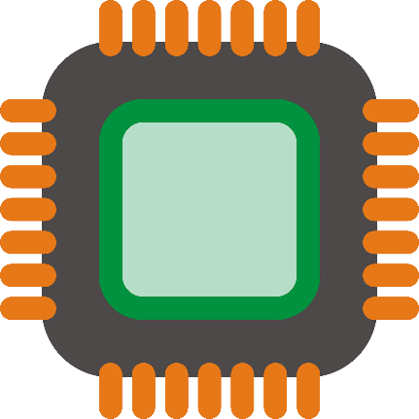
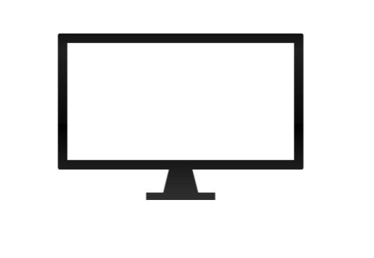
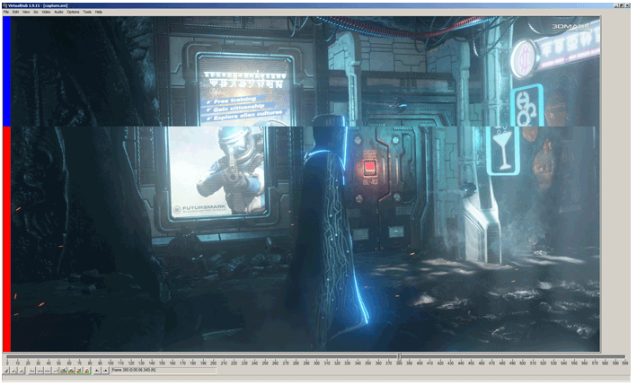
Single Buffering vs Double Buffering
Single Buffering
buffer
frame
frame
CPU continuously draw frame to buffer
Monitor continuously display frame from buffer
Monitor may display uncompleted frame
→ tearing

Slide 34
Single Buffering vs Double Buffering
Double Buffering
Back buffer
frame
Front buffer
frame
CPU continuously draw frame to back buffer
Monitor continuously display frame from front buffer
Monitor always display completed frame
Back buffer stores latest frame

Slide 35
Single Buffering vs Double Buffering
Double Buffering
Front buffer
frame
frame
Back buffer
To display the latest frame, monitor should load frame from other buffer
Role of front buffer and back buffer changes
This is called flipping

Slide 36
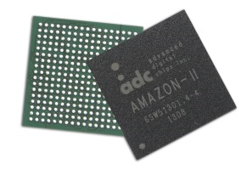
Single Buffering vs Double Buffering
Double Buffering
Front buffer
frame
frame
Back buffer
Type 5 to load AMAZON2.bmp
Type 6 to draw AMAZON2.bmp to back buffer

Slide 37
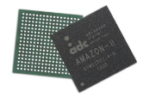
Single Buffering vs Double Buffering
Double Buffering
Back buffer
frame
Front buffer
frame
Type 0 to flip back buffer and front buffer

Slide 38

Single Buffering vs Double Buffering
Double Buffering
Back buffer
frame
Front buffer
frame
Type 2 to draw red rectangular to back buffer

Slide 39
Single Buffering vs Double Buffering
Double Buffering
Front buffer
frame
frame
Back buffer
Type 0 to flip back buffer and front buffer

Slide 40
Single Buffering vs Double Buffering
Double Buffering
Front buffer
frame
frame
Back buffer
Type 1 to clear back buffer

Slide 41
Single Buffering vs Double Buffering
Double Buffering
Back buffer
frame
Front buffer
frame
Type 0 to flip back buffer and front buffer

Slide 42
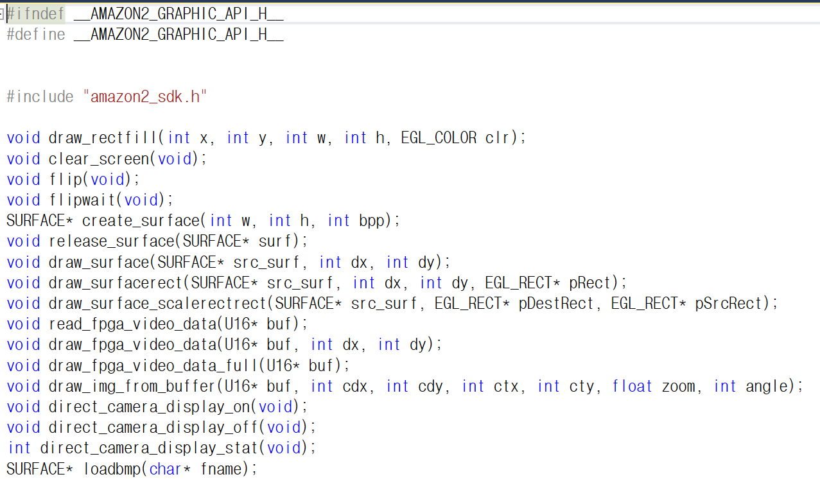
Demo SW
Demo SW Execution

